Slide 1

18CSE392T – Machine Learning I
Department of Data Science and Business Systems

Slide 2
Regularization

Slide 3
Definition
Regularization is a technique used to reduce the error by fitting a model appropriately on a given training set and in turn helps to avoid over fitting

Slide 4


Linear Regression
Test data
Train data
Salary
Experience

Slide 5
For training data - best fit - good results
(Low bias → Less error )
For test data - Huge error

Slide 6
Overfitting
w.r.t training data → Less error
w.r.t test data → High error
Underfitting
w.r.t training data → High error
w.r.t test data → High error

Slide 7
Types of Regularization
L2 Ridge Regression
L1 Lasso Regression
By using L1 and L2 regularization, we can convert High variance to Low variance

Slide 8
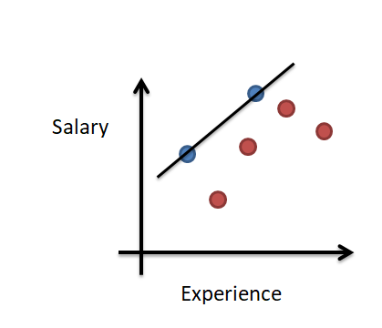
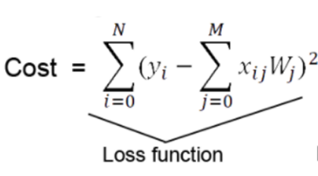
L2 - Ridge Regression

Slide 9
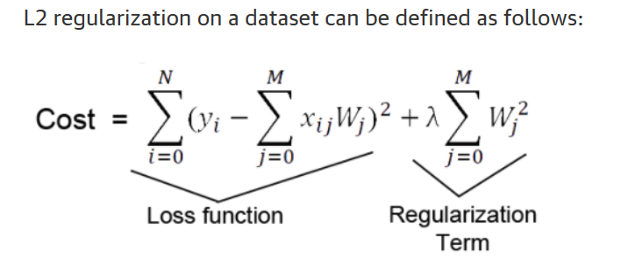
W_{j} – slope

Slide 10
Loss function is the traditional loss function where y is the dependent variable, x is the independent variables, and W is the kernel (weight matrices).
The regularization term is added to the loss function. Note the regularization value is the sum of squared weight values across all the dimensions of a weight matrix.

Slide 12
L1 – Lasso Regression
Not only for reducing the overfitting
Also for feature selection (less slopes are removed – Extra features)
Y= m₁x₁ + m₂x₂+ m₃x₃ + m₄x₄ +...+m_{n}x_{n} +C
α * | m₁ +m₂ +m₃ + ...+ m_{n}|

Slide 13
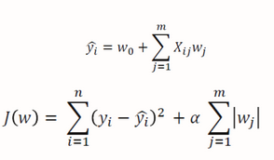
L1 – Lasso Regression

Slide 14
Learning Curves
A learning curve is a plot of model learning performance over experience or time.
Learning curves of model performance on the train and validation datasets can be used to diagnose an underfit, overfit, or well-fit model

Slide 15
Cont..
Train Learning Curve: Learning curve calculated from the training dataset that gives an idea of how well the model is learning.
Validation Learning Curve: Learning curve calculated from a hold-out validation dataset that gives an idea of how well the model is generalizing.
Optimization Learning Curves: Learning curves calculated on the metric by which the parameters of the model are being optimized, e.g. loss.
Performance Learning Curves: Learning curves calculated on the metric by which the model will be evaluated and selected, e.g. accuracy.

Slide 16


